Slide 1
PulseFit: Business Intelligence Implementation
Transforming Fitness Data into Operational Excellence
By Mohamedkarim Nsaibi, Rayen Ghourabi, And Jasser Sghaier
Junior BA/IT Project - BI & DBM

Slide 2
Design & Branding (PulseFit Identity)

Slide 3
Industry Description :The fitness and sports industry has grown rapidly due to rising health awareness and lifestyle changes. Fitness clubs operate in a competitive market where customer retention, service quality, and efficiency are key. As a result, data-driven decision-making is essential to understand member behavior, optimize operations, and increase profitability.
Organization Description :PulseFit is a multi-branch fitness club operating across major cities in Tunisia. It offers various membership plans, classes, personal training, and modern equipment. While branches operate independently, they report to a central management team, and although data is collected across operations, it lacks a unified analytical view.

Slide 4
The Business Problem

Slide 5
Core Issues:
High member churn in the first 3 months.
Inconsistent revenue data across 5 branches.
Manual, error-prone tracking of class attendance.
Objective:
Build a scalable BI solution to visualize performance and drive retention.

Slide 6
The Data Journey (ETL)

Slide 7
Source Data :6 Raw CSV datasets (Members, Visits, Payments, Trainers, Classes, Bookings).
The Challenge :Data was "dirty" (inconsistent phone formats, typos, orphan records).
Solution :Automate cleaning via Python (Pandas).
Result :100% referential integrity between Fact and Dimension tables.

Slide 8
Data Architecture (Star Schema)

Slide 9
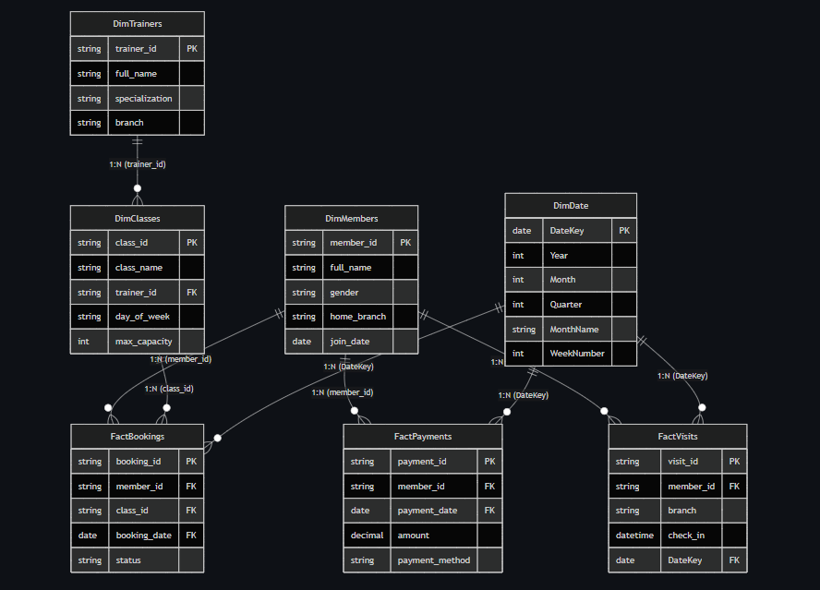

Slide 10
Fact Tables :FactPayments, FactVisits, FactBookings.
Dimension Tables :DimMembers, DimTrainers, DimClasses, DimDate.
Design Choice :Galaxy Schema implementation for optimal Power BI performance and time-intelligence calculation (MOM, YOY).

Slide 11
Dashboard Overview (Executive Summary)

Slide 12
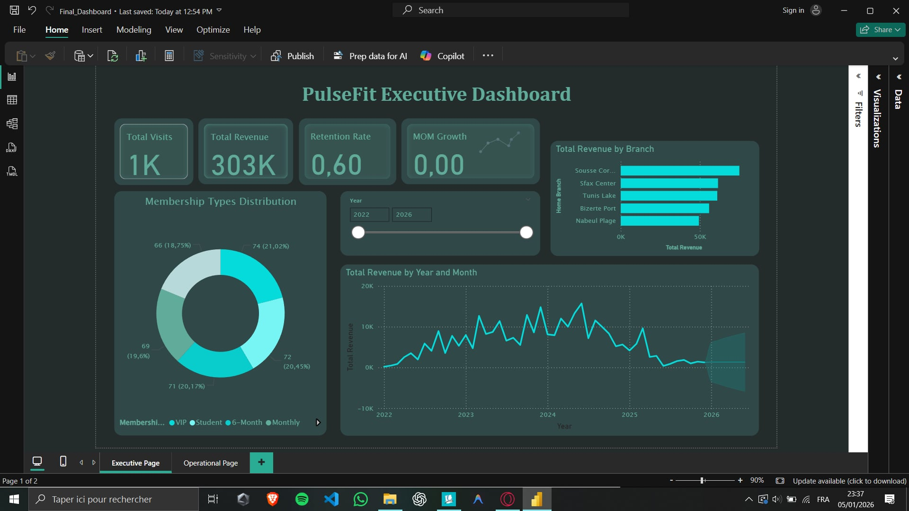
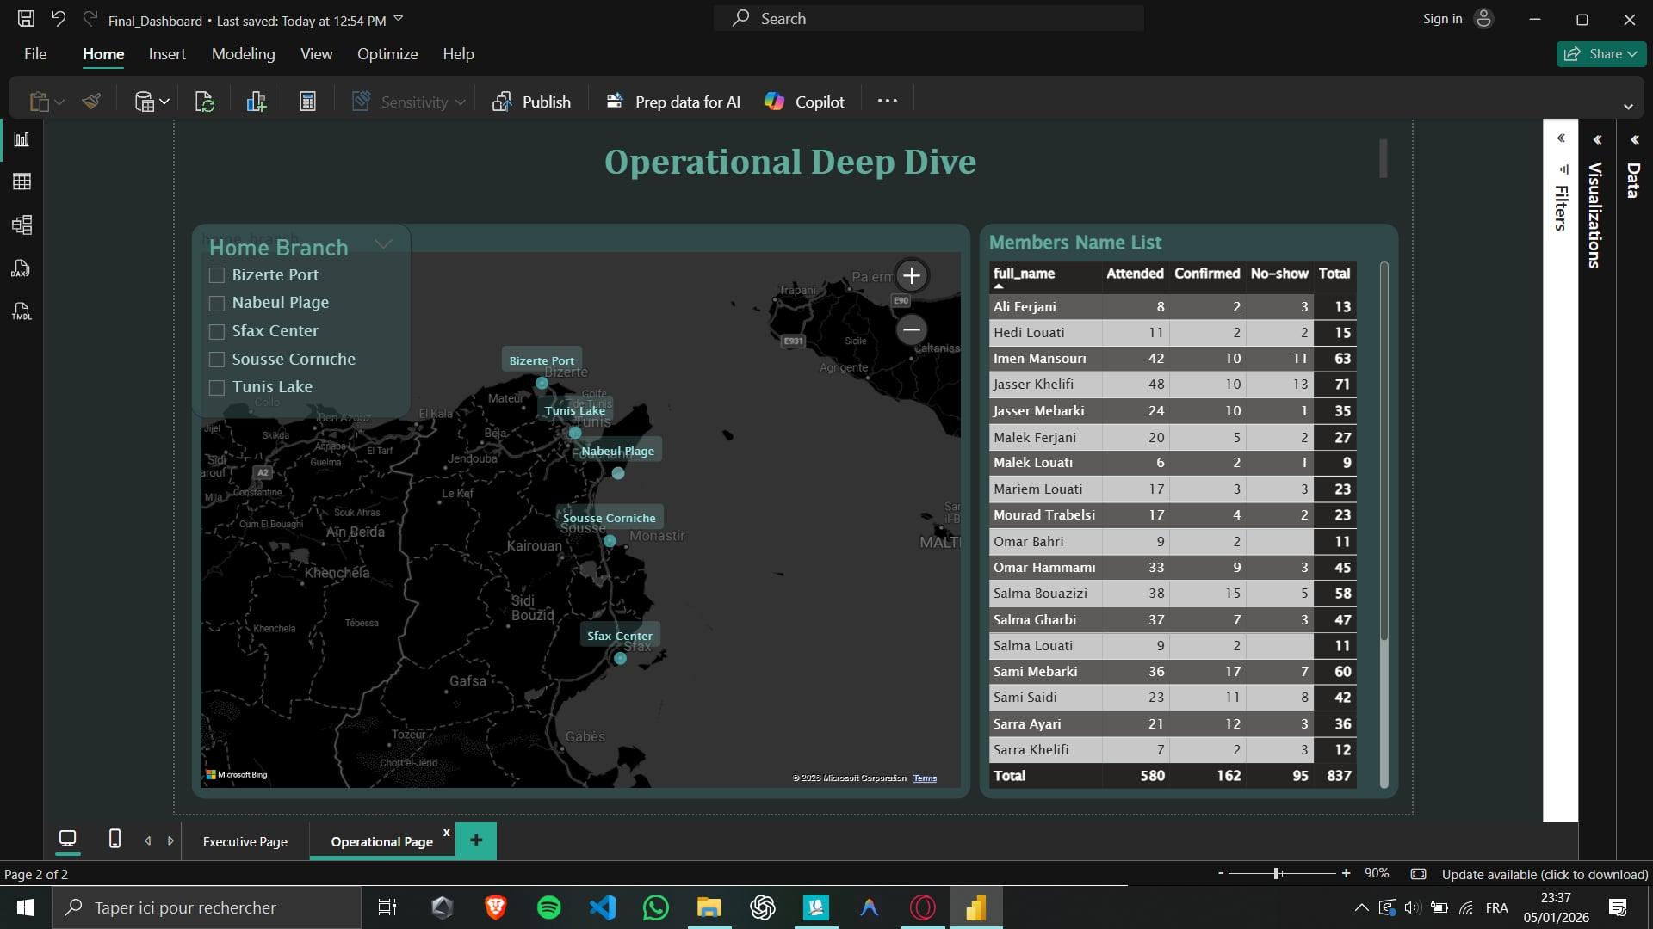
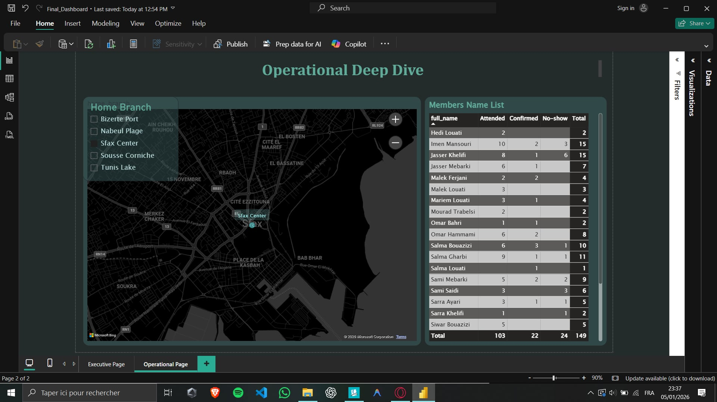
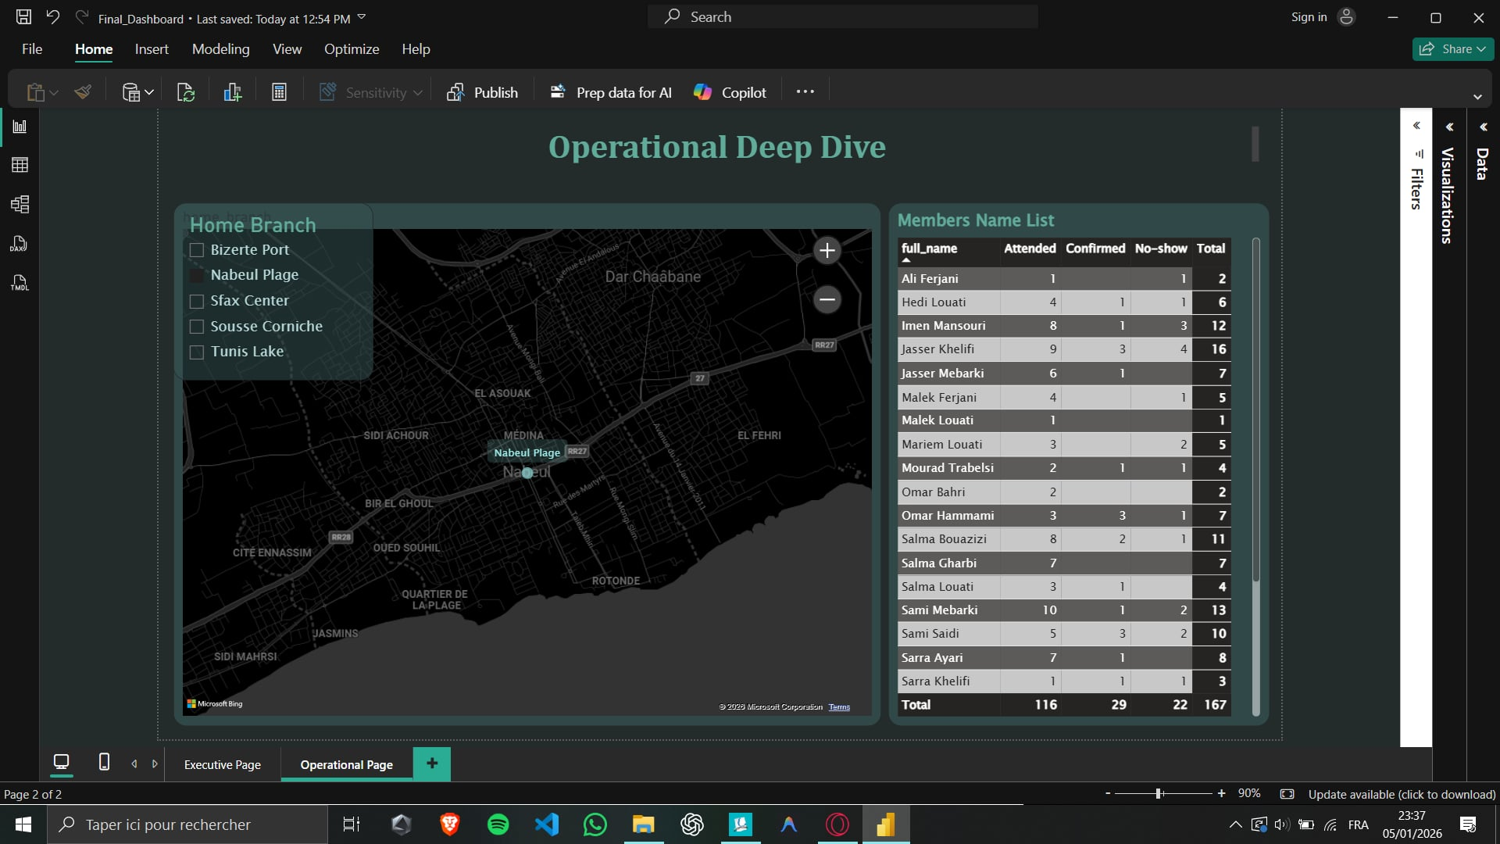

Slide 13
Key High-Level Metrics:
Total Revenue (Top KPI)
Active Members vs. Churn Rate
Branch-wise Revenue Distribution (Tunis, Sousse, Sfax, Nabeul, Bizerte).
Interactive Features:
Slicers for Branch and Membership Type to enable "on-the-fly" filtering.

Slide 14
Advanced Analytics (Deep Dive)

Slide 15
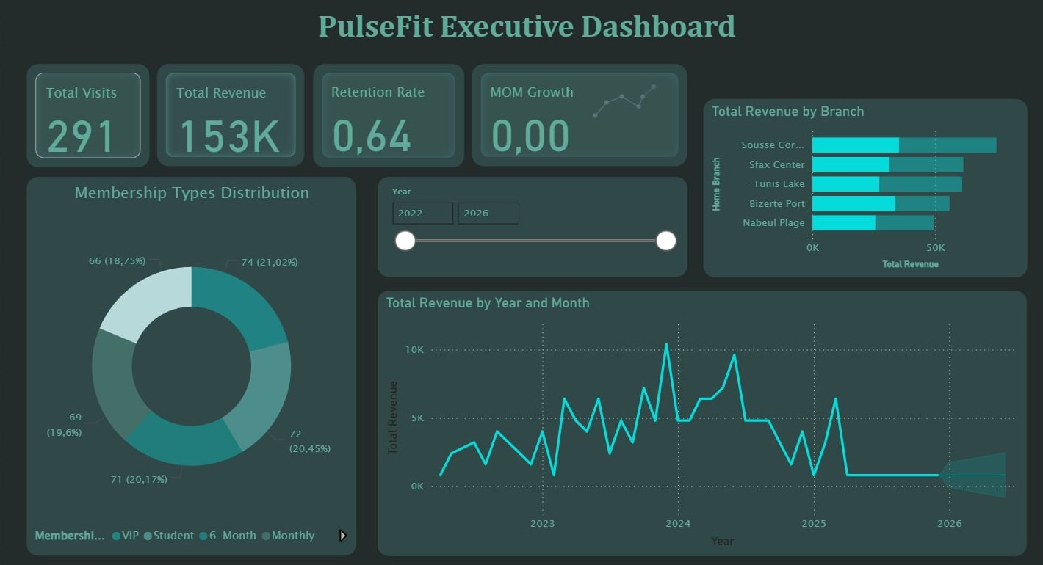
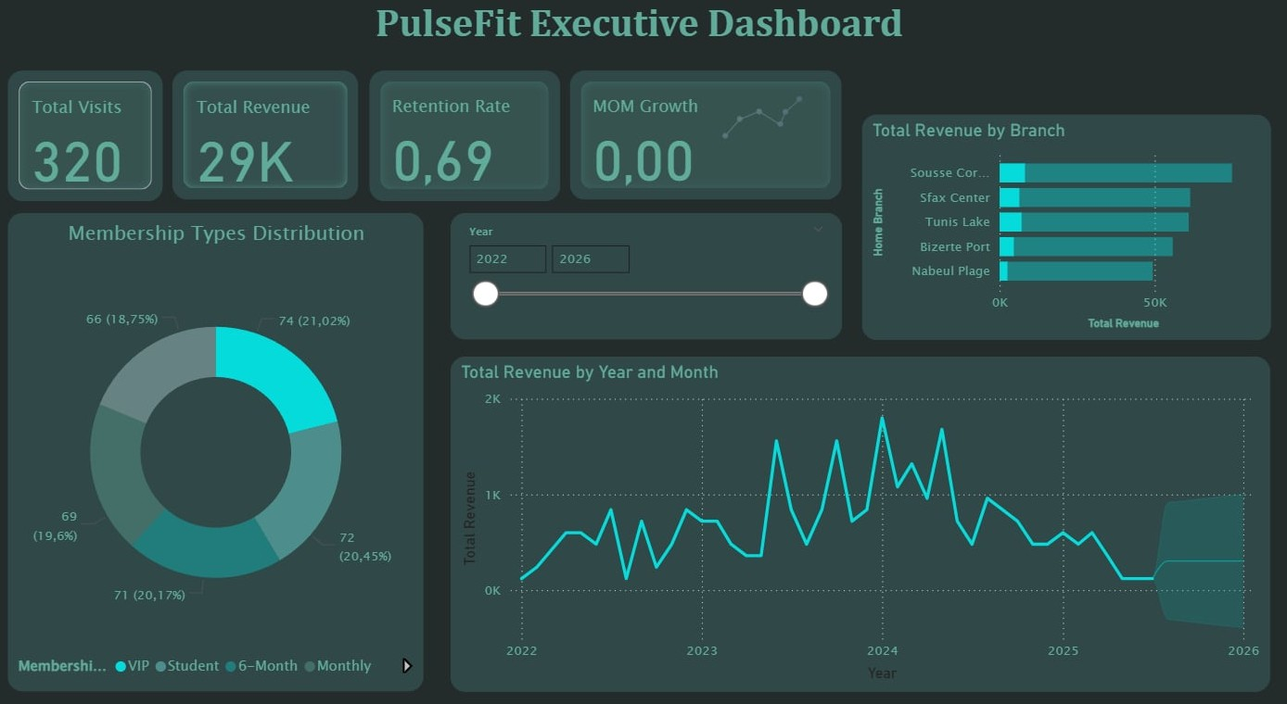
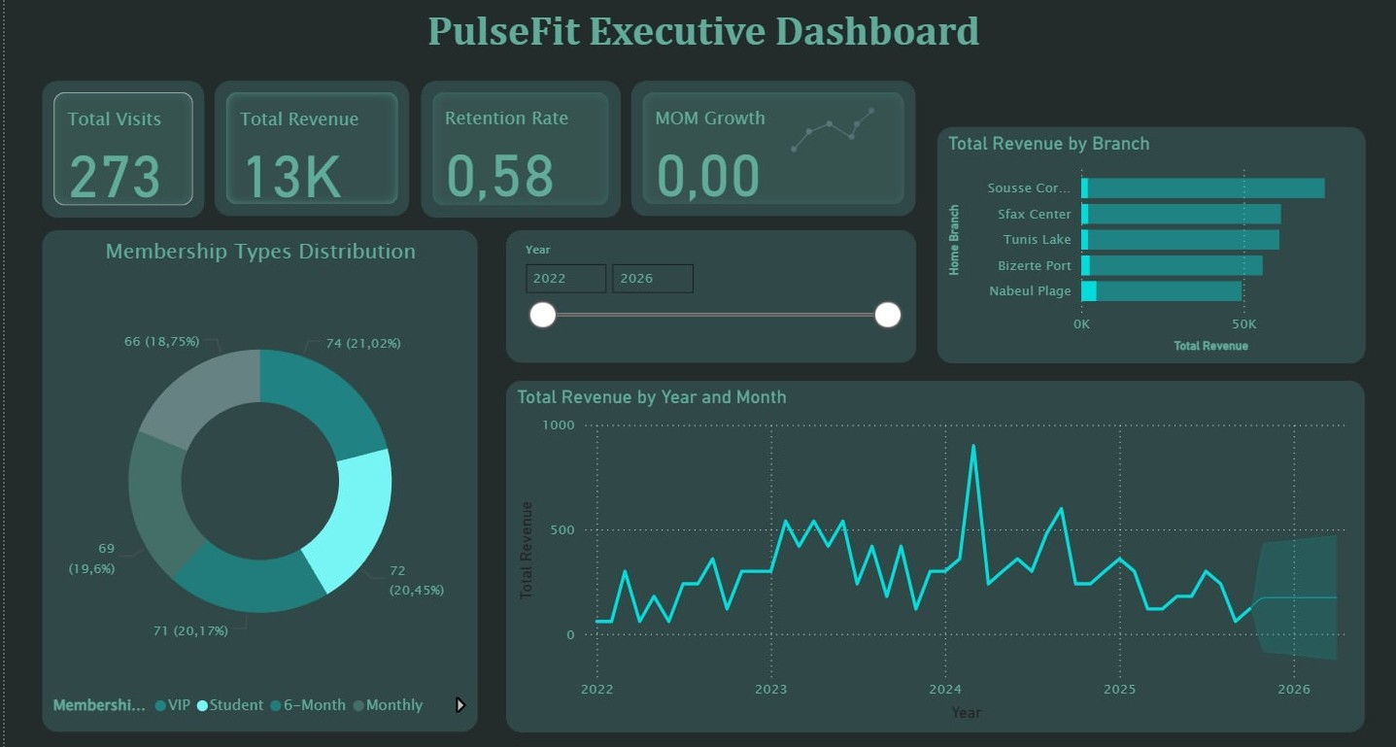
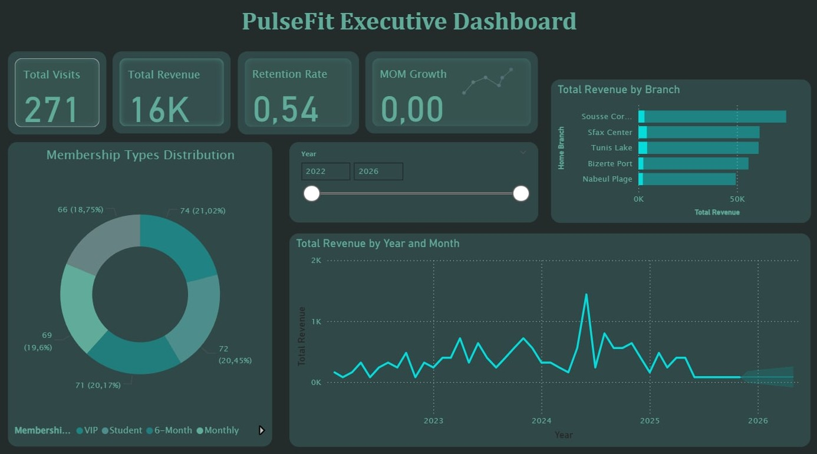
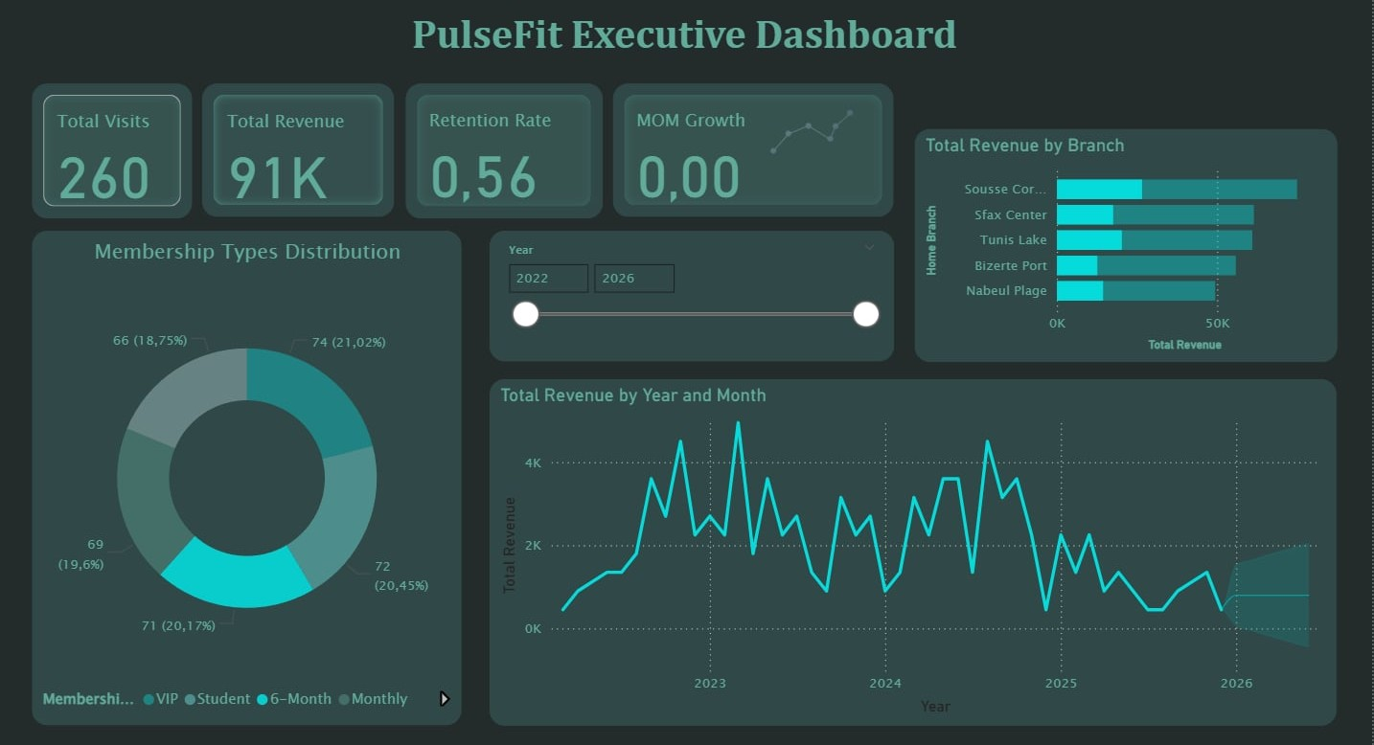

Slide 16
Forecasting: Predicting Revenue trends for the next quarter.
Engagement Tracking: Identifying "Dead Slots" vs. Peak Hours.
Drill-through Capability: Analyzing specific branch performance from a high-level view.

Slide 17
Business Insights & Action Plan

Slide 18
Observation:
VIP members have a 40% higher retention rate than Monthly members.
Recommendations:
Target "Annual" members with loyalty bonuses to reduce churn.
Optimize trainer scheduling in Nabeul based on weekend peak occupancy.
Implement automated alerts for "Inactive" members (10+ days since last visit).

Slide 19
Conclusion

Slide 20
Summary: We have moved PulseFit from manual guesses to data-driven certainty. Outcome: A robust, automated pipeline ready for scaling to new branches.

Slide 21
THANK YOU FOR YOUR ATTENTION

